Slide 1
Deployment Approaches for WSNs
Marija Milanović, Vladimir Filipović, Veljko Milutinović

Slide 2
Preliminaries
Coverage:
How well the sensor network observes a field of interest
Three types:
  Area
  Point
  Barrier coverage
Redeployment:
Adding new sensors to an existing deployment

Slide 3
Classification Tree and Examples
Redeployment
Barrier Retreatment
ΔA
Barrier Reduction
ΔL
EXAMPLES:
[Tafa 2011]
[Yang 2010]
[Chen 2008/9]
[Clouqueur 2002]
[Kosar 2009/11]
[Batalin 2004/7] [Kumar 2005]
[Mei 2007] [Drougas 2007]
[Fletcher 2010] [Vieira 2004]
[Chang 2011] [Megerian 2005]
[Sheu 2008] [Rahman 2007]
[Tong 2009/10/11] [Hou 2010]
[Lee 2008/10] [Shiu 2011]

Slide 4
Barrier Retreatment (via aircraft) - 1
Assumptions:
Randomly deployed network, stationary of hybrid
Goal:
Achieve barrier coverage by redeployment via aircraft
[Tafa 11]:
  Identify gaps as spaces between connected clusters of sensors
  Distribute mobile nodes evenly in each gap

Slide 5
Barrier Retreatment (via aircraft) - 2
[Chen 2008]:
  Introduced a metric for measuring the quality of k-barrier coverage on a belt region
  Identify all weak zones that are to be repaired
  in order the whole region to have the required quality of coverage.
Quality of k-barrier coverage, Q_{k} :
The quality of a sensor deployment for k-barrier coverage, denoted by Q_{k},
is defined to be maximum L
such that the belt is L-local k-barrier covered;
i.e. Q_{k} = max{L: the belt is L-local k-barrier covered}.
If there is no such L, then define Q_{k} = -1.

Slide 6
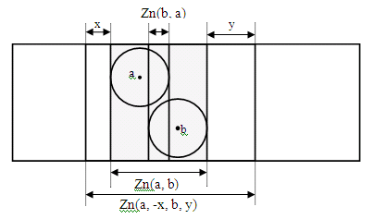
Critical k-barrier covered zone:
For two sensor nodes a and b such that Zn(a,b) ≠ Ø,
Zn(a, b) is said to be a critical k-barrier covered zone
if the following conditions are all satisfied:
  Zn(a, b) is k-barrier covered;
  there exists δ > 0 such that
  Zn(a, -δ, b, 0) and Zn(a, 0, b, δ) are both k-barrier covered;
  for any ε > 0 Zn(a, - ε, b, ε) is not k-barrier covered.

Slide 7
Barrier Retreatment (via aircraft) - Discussion
High deployment cost
Minimum number of sensors
Hostile environments – the only choice
Most researches:
  have centralized algorithm implementation
  use unrealistic sensing model
  consider only the case k=1
  do not use flexibility of mobile sensors

Slide 8
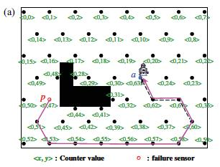
Barrier Reduction (via robot) – 1
Healing of existing coverage holes, [Chang 2011]

Slide 9
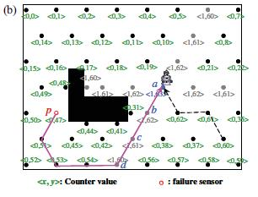
Barrier Reduction (via robot) – 2
[Chang 2011], X-correction mechanism

Slide 10
Barrier Reduction (via robot) – 3
Replacing low-energy sensors, preventing holes to appear, [Tong 2011] “Adaptive rendezvous-based two tier scheduling scheme” (ARTS)
Mobile repairman:
  periodically traverses the sensor network,
  reclaims nodes with low or no power supply,
  replaces them with fully charged ones and
  brings the reclaimed nodes back to an energy station for recharging.
The scheme considers point coverage.

Slide 11
Barrier Reduction (via robot) - Discussion
Most researches:
  assume robot can carry all necessary sensors
  do not consider remaining robot’s energy and/or presence of obstacles
  present solutions rather impractical for large-scale networks

Slide 12
Deployment Approaches for WSNs
Marija Milanović (marija.milanovic@gmail.com),
Vladimir Filipović (vladaf@matf.bg.ac.rs),
Faculty of Mathematics, University of Belgrade
Veljko Milutinović (vm@etf.rs)
School of Electrical Engineering, University of Belgrade
Thank you for your attention!

